Slide 1

Study Buddy Pomodro Timer
Boosting Productivity, One Timer at a Time
https://github.com/ksu-is/StudyBuddy1
Kenny Le

Slide 2
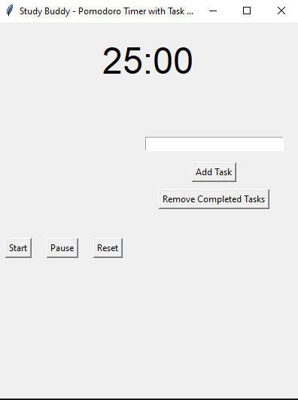
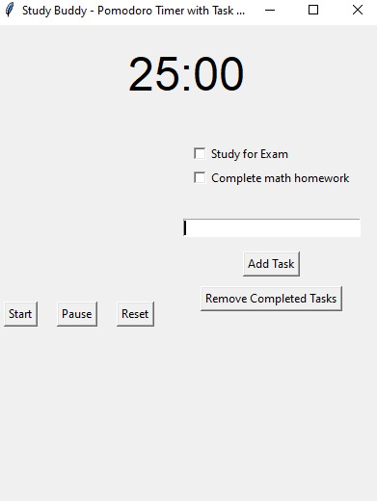
What is it?
A simple app that combines a Pomodoro timer and a to-do list, helping students stay focused and organized by managing study sessions and tracking completed tasks.
What it looks like:

Slide 3
How Study Buddy works
The Study Buddy with Pomodoro Timer is a productivity tool designed to enhance focus and efficiency during study sessions. It incorporates the Pomodoro technique, a time-management method that breaks work into intervals (traditionally 25 minutes) followed by short breaks. It tracks your progress, helps manage tasks, and ensures consistent breaks to avoid burnout.

